Slide 1
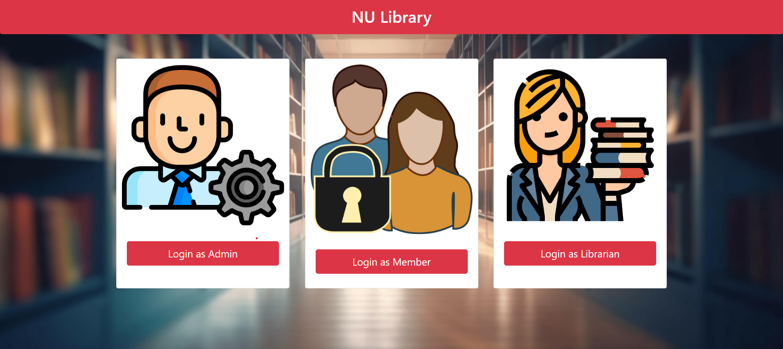
NU LIBRARY

Slide 2
NU Library - Group 3
Team Members:
Sai Siddhardha Chebrolu
Swetha Paturu
Sai Kumar Reddy Vakiti
Shiva Bhargav Bhuvanam
Sanath
Harika Purma
Agni Chaturvedi
Kamal Kotgire
Sushma Mangalampati

Slide 3
NU Library - Overview
Technology Stack:
Frontend: Bootstrap, HTML, CSS
Backend: Java, Spring Boot

Slide 4
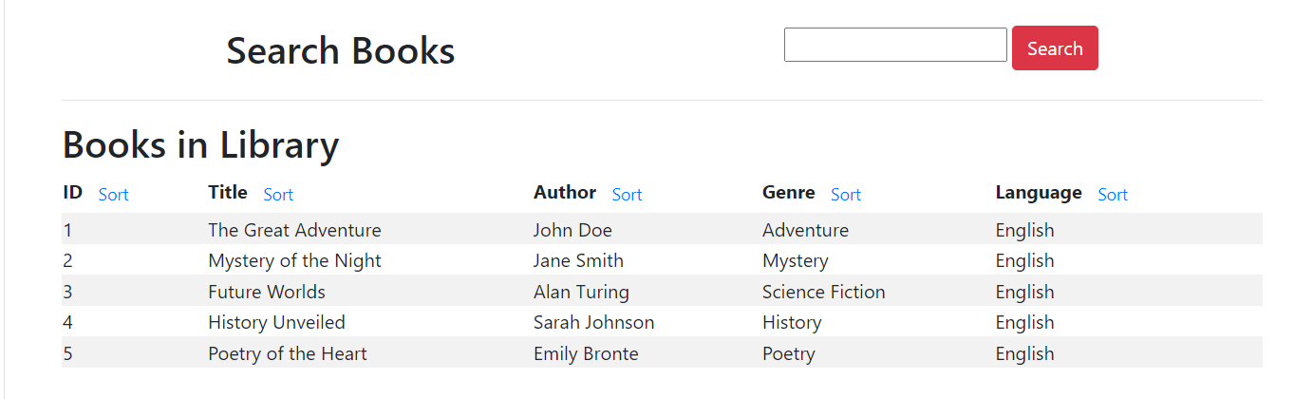
Admin Role & Functionalities
Access to a centralized dashboard displaying key metrics and summaries.
View and manage the entire catalog of books.
Add, edit, or remove books from the library inventory.

Slide 5
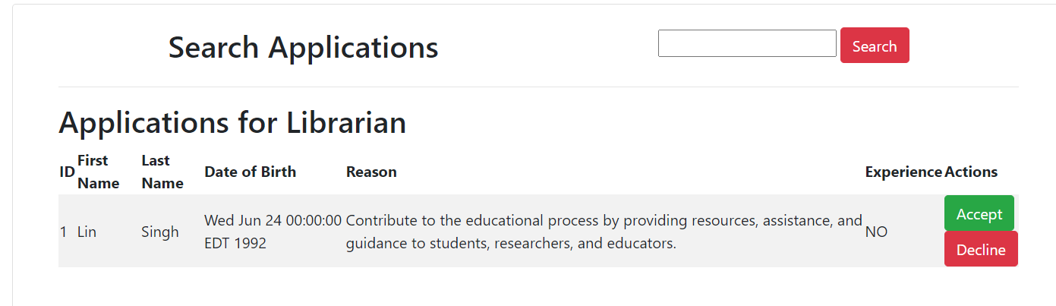
Admin Role & Functionalities
Monitor and manage the list of registered members.
View member details and activity history.
Receive and review applications from individuals interested in becoming librarians.
Approve or reject applications based on criteria.
Administer the allocation and scheduling of private rooms for members.

Slide 6
Member Role & Functionalities
Borrow Requests:
Request to borrow books from the library catalog.
Check the status of pending borrow requests.
Browse and request private rooms for study or meetings.
View availability and confirm bookings.

Slide 7
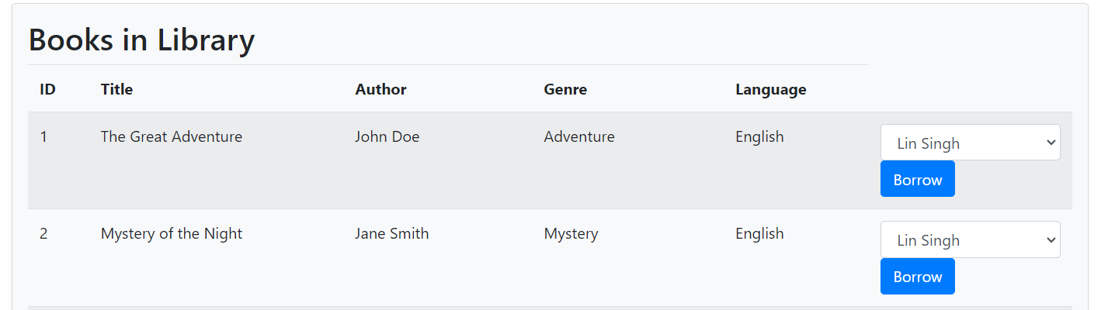
Member Role & Functionalities
Borrowed Books:
View a list of currently borrowed books.
Access due dates and renewal options.

Slide 8
Librarian Role & Functionalities
Borrow Requests
Receive notifications and manage incoming borrow requests.
Approve or deny requests based on book availability.
Handle return requests and update the book status accordingly.
Access a simplified view of the library catalog to assist with inquiries.

Slide 9
Books Management
Search and Filters:
Utilize a robust search and filter system for efficient book retrieval.
Sort books by genre, author, availability, etc.
Book Details:
Access detailed information about each book, including author, publication date, and availability status.

Slide 10
Borrowing and Returning
Borrowing Process:
Clear, step by step guide on how members can request and borrow books.
Confirmation messages and notifications for successful requests.
Returning Process:
Simple instructions for members on returning borrowed books.
Notifications for successful returns.

Slide 11
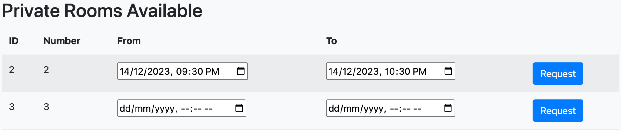
Private Rooms
Requesting Private Rooms:
Easy to-follow process for members to request private rooms.
Information on room availability and reservation confirmation.

Slide 12
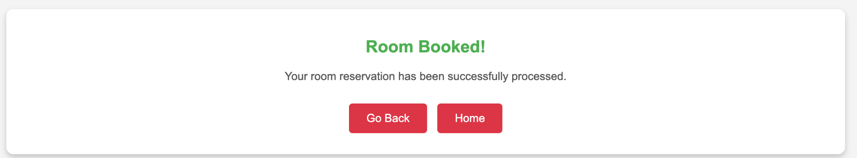
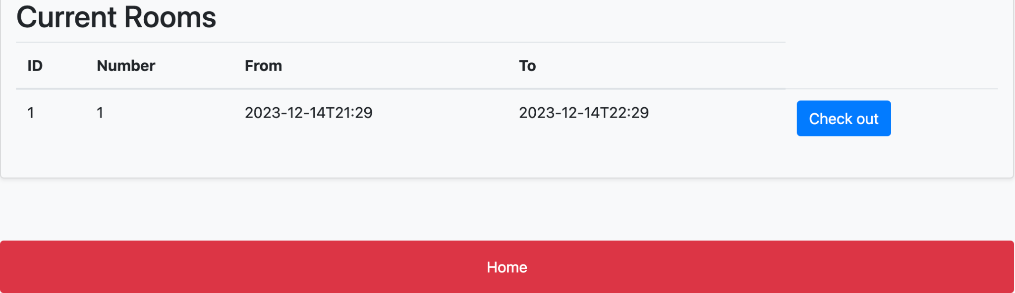


Slide 13
Team Members Contribution
Admin (Frontend & Backend):
Sai Siddhardha Chebrolu
Sai Kumar Reddy Vakiti
Shiva Bhargav Bhuvanam
Librarian (Frontend & Backend):
Swetha Paturu
Sushma Mangalampati
Agni Chaturvedi
Member (Frontend & Backend):
Kamal Kotgire
Sanath
Harika Purma

Slide 14
THANK YOU

